Slide 1
Swift short term optimizer
Modeling & Implementation

Slide 2
The Problem
A short term optimizer that can optimize the daily generation for a given period (one month up to a year)
A tool for both planner / schedulers
Inputs
Daily Price Forecast
Initial Elevation
Daily Inflow Forecast
Forebay Targets (Optional)
Daily Generation Targets (Optional)
Operating constraints (Optional)
A perfect opportunity to study quadratic optimization
A much ‘cleaner’ model than the Slice one

Slide 3
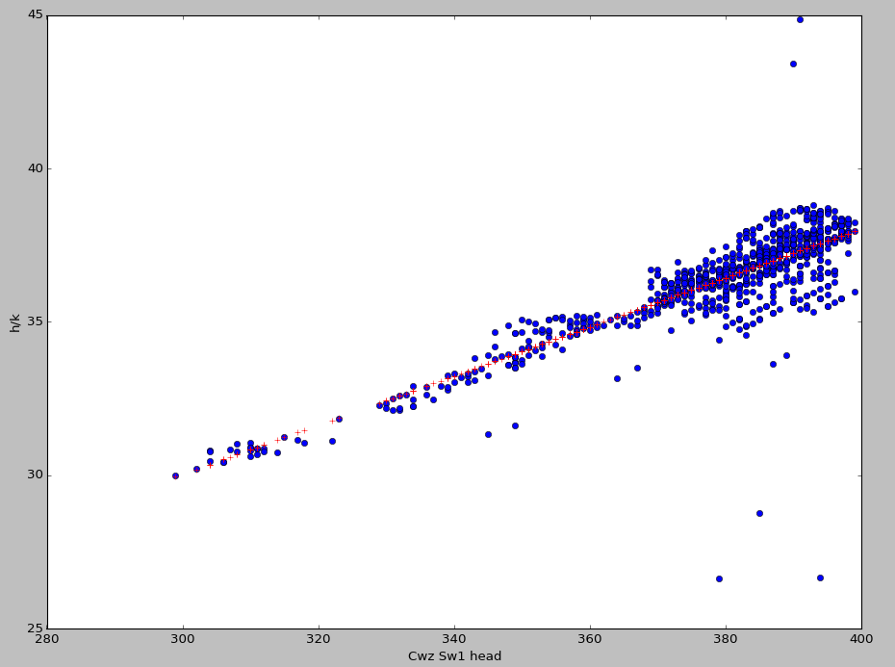
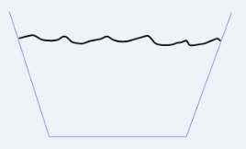
The Hydro model
Vol = 0.0078Fb² - 10.986Fb + 3958.3 (Natalie) [388.9,772.3]
Fb = 704.23078 + 11.32277 * sqrt(vol - 89.96) [900-1000]
Hk = 14.36 + 0.907 * sqrt(Vol – 89.96) [30-38]
Gen = Hk * TurbFlow
Disch = TurbFlow + Spill
Vol[i+1] = Vol[i] + Inflow[i] – Disch[i]

Slide 4
The Optimization Objective
The total revenue
Σ_{i} (Prices[i] * Qp[i] * Hk[i]), i = 1,…,n
Non-linear!
Total penalty for deviating from the Forebay (or Volume) Targets
Σ_{i}(vol_target_penalty[i] * | Vol[i] – Vol_Target[i] |)
Total penalty for deviating from the Generation Targets
Σ_{i} (gen_target_penalty[i] * | Gen[i] – Gen_Target[i] |)
Non-Linear!
Water value function (Optional)
We value the remaining water in the reservoir by the average price in the optimization period

Slide 5
Modeling Challenge
Not possible to implement the quadratic objective directly
Σ_{i} (Prices[i] * Qp[i] * Hk[i]), i = 1,…,n
Note PSD = Convexity!
Cholesky decomposition: Q is PSD, iff exists H, s.t. Q = H^{T}H
So, for any x, x^{T}Qx = x^{T}H^{T}Hx = |Hx|² >= 0 (PSD)
Absolute values are hard to model if it contains non-linear term
Σ_{i}(gen_target_penalty[i] * | Gen[i] – Gen_Target*[i] |)

Slide 6

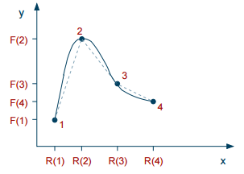
Trick - Separation of Variables
x * y = u² – v² where u = (x+y)/2, v = (x-y)/2
So
Σ_{i} (Prices[i] * Qp[i] * Hk[i]) Σ_{i} (Prices[i] * (u[i] ²+ v[i] ²))
Then use piecewise linear (PWL) objective for u² and v², respectively.
PWL: a new feature added in Gurobi 6.5!
Gurobi converts them to SOS2 Constraints
At most two are non-negative
Non-negative ones must be adjacent

Slide 7
Same trick continues…
How to deal with absolute values?
Turn them into quadratic terms instead
Similarly:
(xy-c) ² = x²y² – 2xy + c²
Note that x²y² = ((x+y)⁴ + (x-y)⁴ – (2x⁴ + 2y⁴))/12
So x²y² = (u⁴ + v⁴) * 4 / 3 – (x⁴ + y⁴) / 6, u = (x+y)/2, v = (x-y)/2
So far, all the multiplicative terms are separated!
However, we end up with much more complex models (with lots of SOS2 constraints)
Σ_{i} (gen_target_penalty[i] * | Gen[i] – Gen_Target*[i] |)

Slide 8
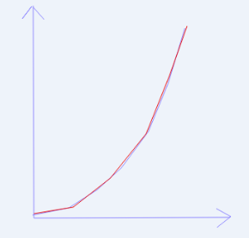
Implementation
Python 2.7
Gurobi 6.5
qo[i] = m.addVar(lb=minQo, ub=maxQo, name='qo_{i}'.format(i = i))
m.addConstr(qo[i] == qp[i] + qs[i],'disch_{i}'.format(i=i))
m.setPWLObj(u[i], ucoords, prices[i] * np.power(ucoords, 2))
schedules['Revenue'] = [g * p for (g,p) in zip(schedules['Generation'], prices)]
Variable
X coordinates
Y coordinates

Slide 9
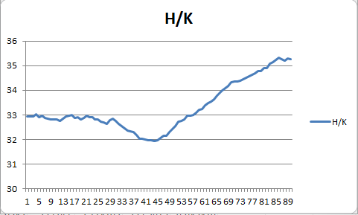
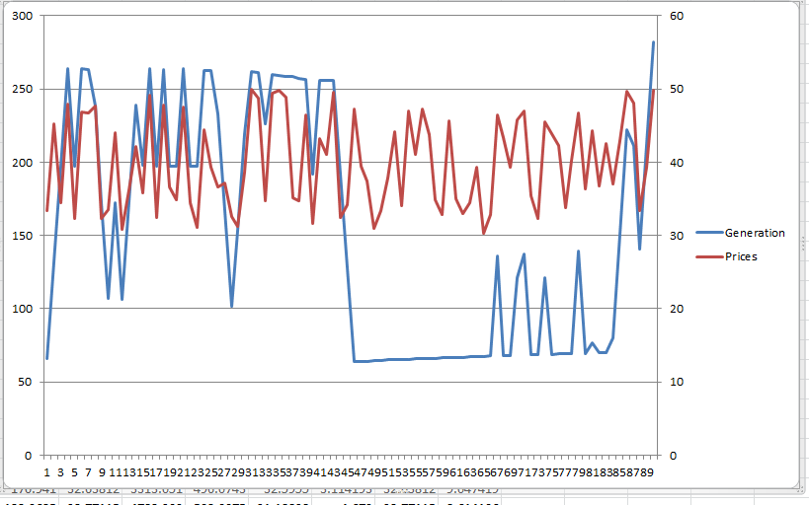
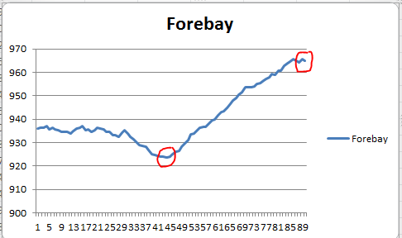
Optimize to Prices
Optimize to random daily prices
Optimizer purposely maintains a high forebay to get high H/Ks
<10 secs to optimize a three-month model

Slide 10
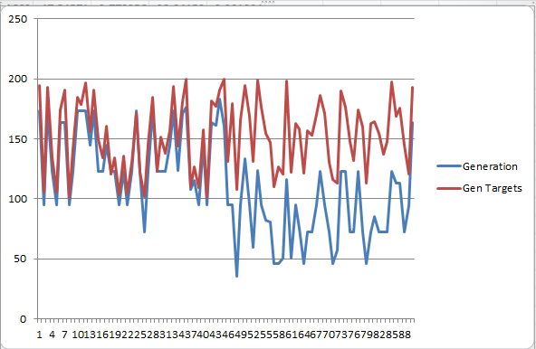
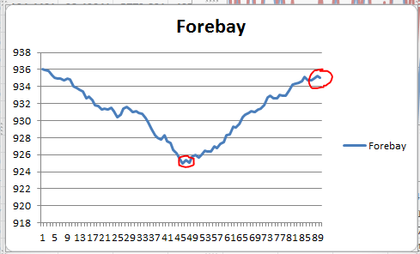
Optimize to Targets
Initial Forebay = 936
Two Fb Targets: 925 and 935
Random Generation Targets
2-5 minutes to find a decent solution for an 3-month model with daily gen targets
Trying to hit the forebay target for the second half of the month

Slide 11
Future Work
How to combine with Natalie’s long term stochastic model?
Any simpler approach to model generation targets?
Can Slice Optimizer benefit from this work?
Content function is not linear or quadratic
Can still model using PWL and SOS2 constraints
Performance can be an issue
Any other PUD with dispatch-able hydro project?

Slide 12
Comments/Questions?

